Slide 1


Slide 2

EMPLOYEE DATASET PROJECT

Slide 3
THE EMPLOYEE DATASET
This project is about the Employee dataset. It consists of various aspects of Employee data including employee details, departmental organization, compensation details, performance evaluations, and banking records.
It includes the following key components:
Employee Details: It consists of employee details such as name, date of birth, contact information, job title, and department assignment.
Departmental Organization: It consists information about company departments details including department names and managers.
Compensation Records: It has salary information, including base salaries, bonuses, and payment dates
Performance Evaluation: Stores employee performance ratings on a scale of 1 to 5.
Banking Details: In this it manages employee banking information, including account numbers, bank names, and IFSC codes.

Slide 4
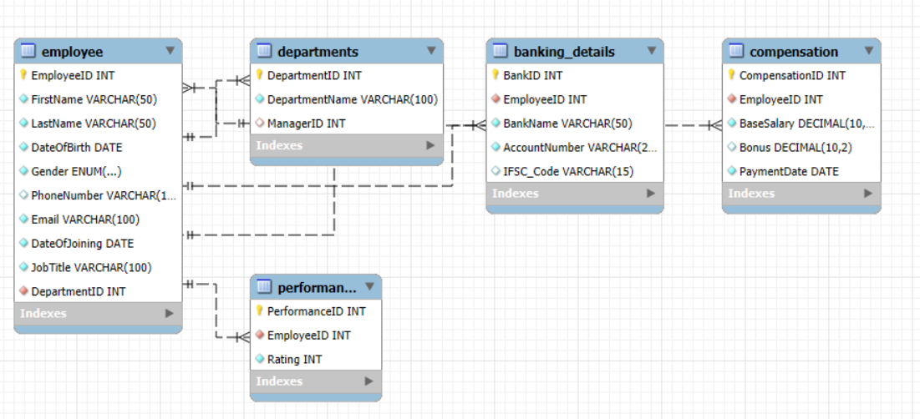
ER-diagram

Slide 5
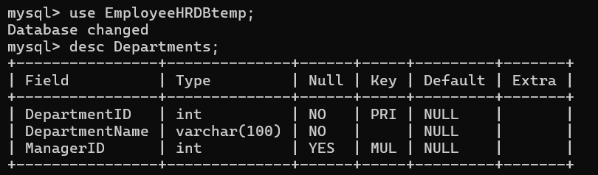
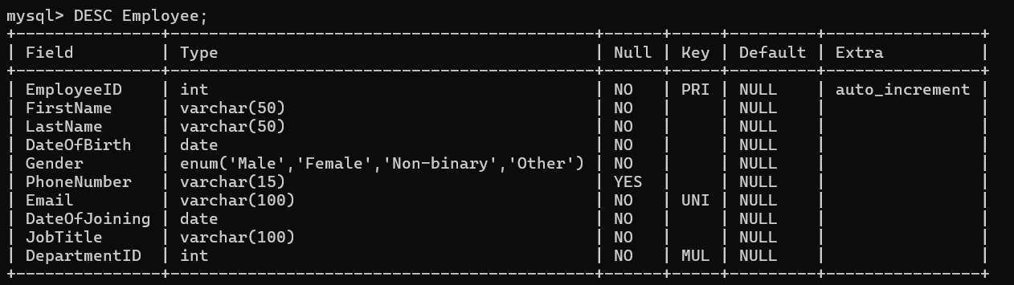
STRUCTURE OF TABLES
DEPARTMENT TABLE
EMPLOYEE DETAILS TABLE

Slide 6
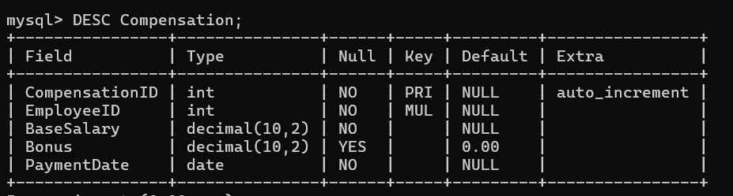
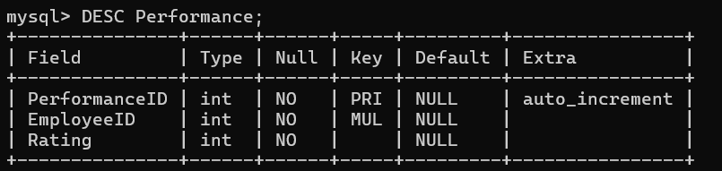
Compensation TABLE
Performance TABLE

Slide 7
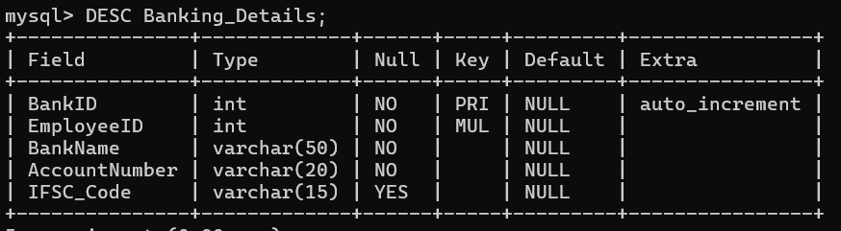
Banking Details TABLE

Slide 8
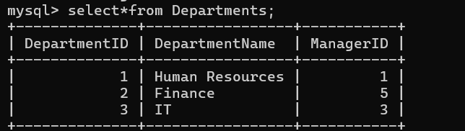
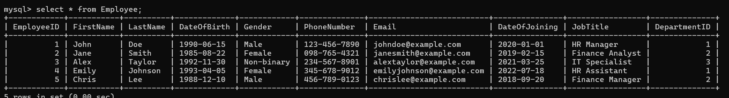
TABLES data
Departments
Employee

Slide 9
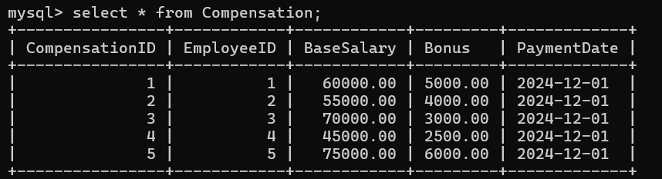
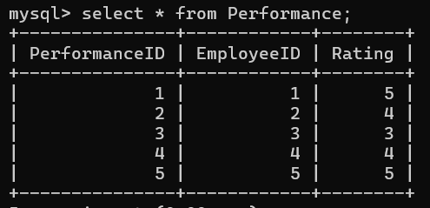
compensation
performance

Slide 10
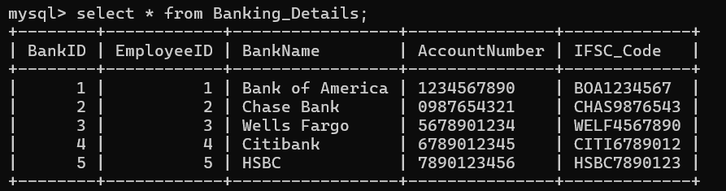
Banking Details

Slide 11
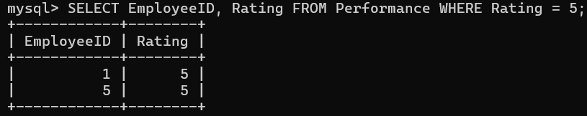
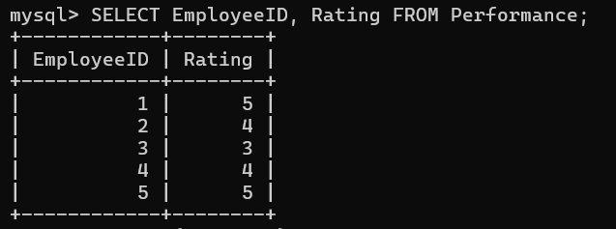
QUERIES
1] find employees with a performance rating of 5
find the performance rating of an employee (Employee ID, Rating

Slide 12
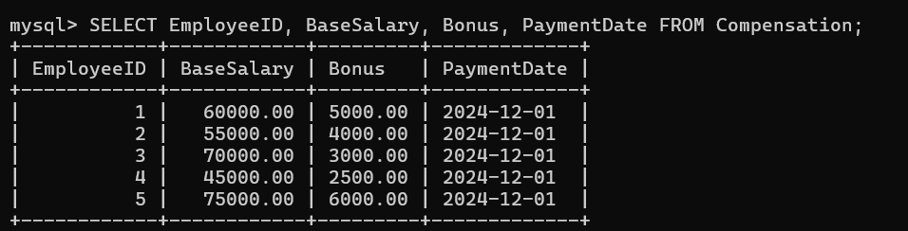
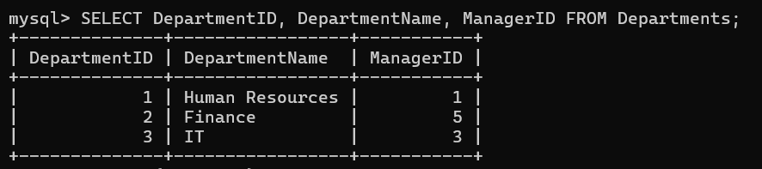
the compensation details (Employee ID, Base Salary, Bonus, Payment Date) for all employees
write all departments and their manager information

Slide 13
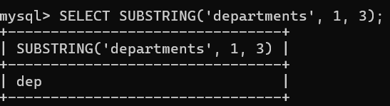
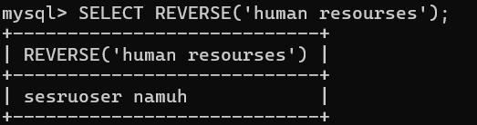
Find substring from the department
Find reverse from human resourses

Slide 14
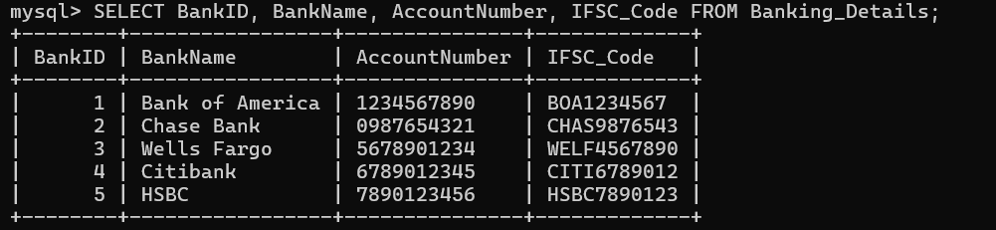
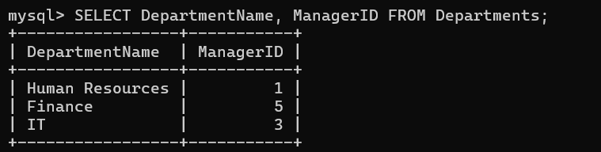
find the banking details (Bank ID, Bank Name, Account Number, IFSC Code) of employees:
find the department names and manager’s from the table EmployeeID

Slide 15
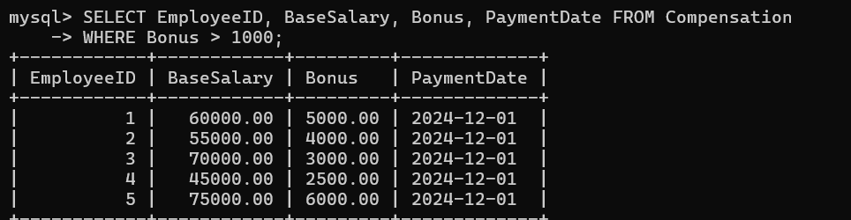
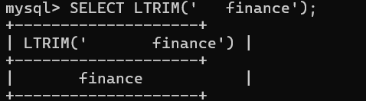
the details of the employees who have a bonus greater than 1000
Find ltrim from the finance

Slide 16
THANK YOU

